Slide 1
World Cup Format Change
Mason Rocco, Joey Pitaniello, Jonah Paoletti, Griffin Green, Jack Feds

Slide 2
Introduction
FIFA has announced their plans to change the format of the World Cup for the upcoming 2026 edition. The biggest change is that the new format will allow for more teams to qualify (48 vs. current 32).
This means that a lot more teams will get to play in the World Cup, and the skill level of the teams that play may not be as prestigious as it has been in the past.
Additionally, confederations like CONCACAF (North/Central America), CAF (Africa), and AFC (Asia) have big increases to the number of teams that will represent them in the new format.

Slide 3
Introduction (cont.)
These changes are sure to affect the outcome of the World Cup in the future. With more teams being allowed to play, as well as an expanded knockout stage, teams will have to win more games to be crowned the champion of the World Cup.
Along with this, we can expect to see many new teams playing in the World Cup, which might lead to the competition being more globally accessible.
Finally, the qualification for the World Cup might become easier for some countries. This is especially true in confederations such as CONMEBOL (South America), which has 10 countries eligible, and up to 7 of them can qualify.

Slide 4
Questions to Answer
How will the changes to the World Cup format affect the different number of teams that will win the competition in the future?
How do the changes affect the teams attempting to qualify for the World Cup?
Which teams will benefit from the changes, and which teams will suffer?
How will the changes be looked at? Will people agree or disagree with the changes?

Slide 5
Data Description
Team Ratings^{1,2}: FIFA's official ratings as of October 6, 2022 (ratings right before the 2022 World Cup)
Formats^{3,4}: From FIFA's official website, the 2026 knockout stage format is not yet confirmed, but there are reports as to what it will likely be.

Slide 6
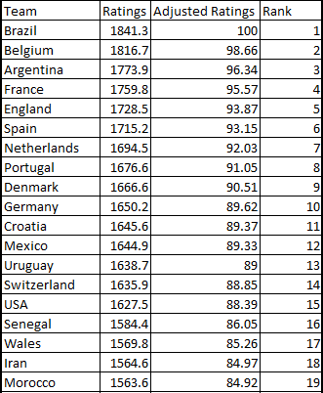
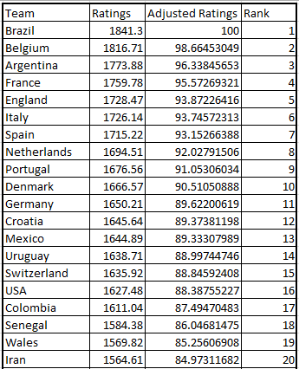
Team Ratings
2022 Ratings (partial)
Projected 2026 Ratings (partial)
Note that teams such as Italy and Colombia are in the 2026 ratings, as with the new format they are involved in the World Cup, while they didn't play in 2022.

Slide 7
Changes to the Format
2022 World Cup:
8 groups of 4 teams (32 total)
Top 2 from each group advance
Round of 16 is a one game playoff
2026 World Cup:
12 groups of 4 teams (48 total)
Top 2 from each group advance
Top 8 third place teams advance
Round of 32 is a one game playoff
Playoff format not yet confirmed

Slide 8
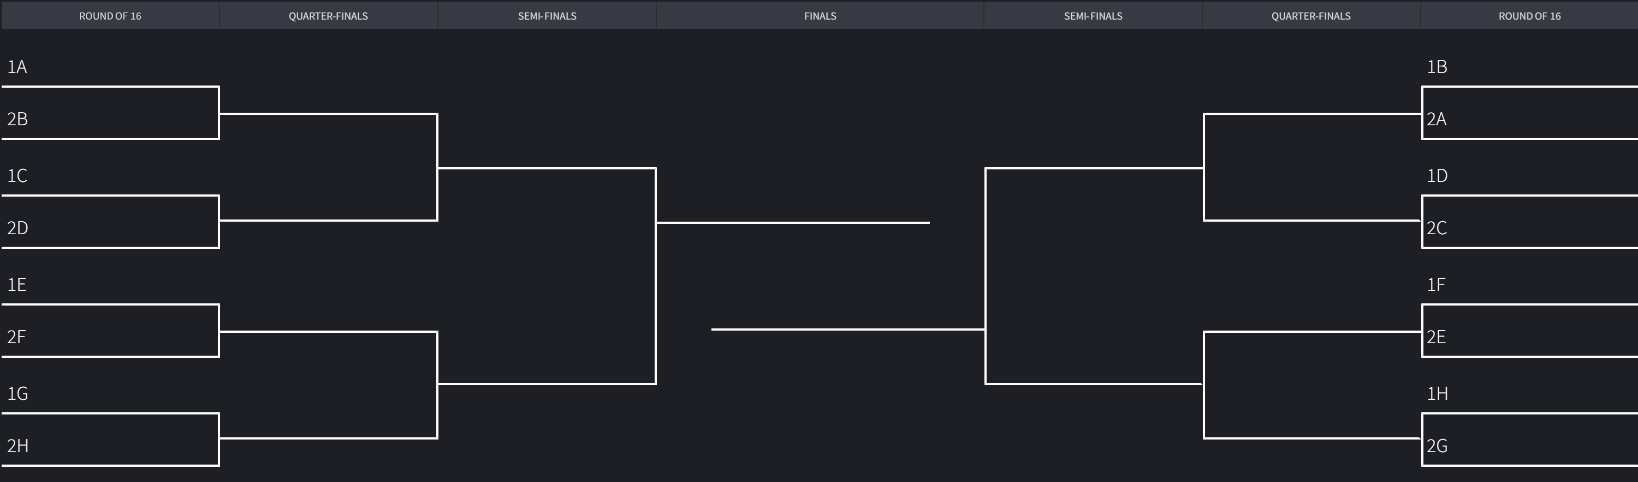
2022 Knockout Stage Format

Slide 9
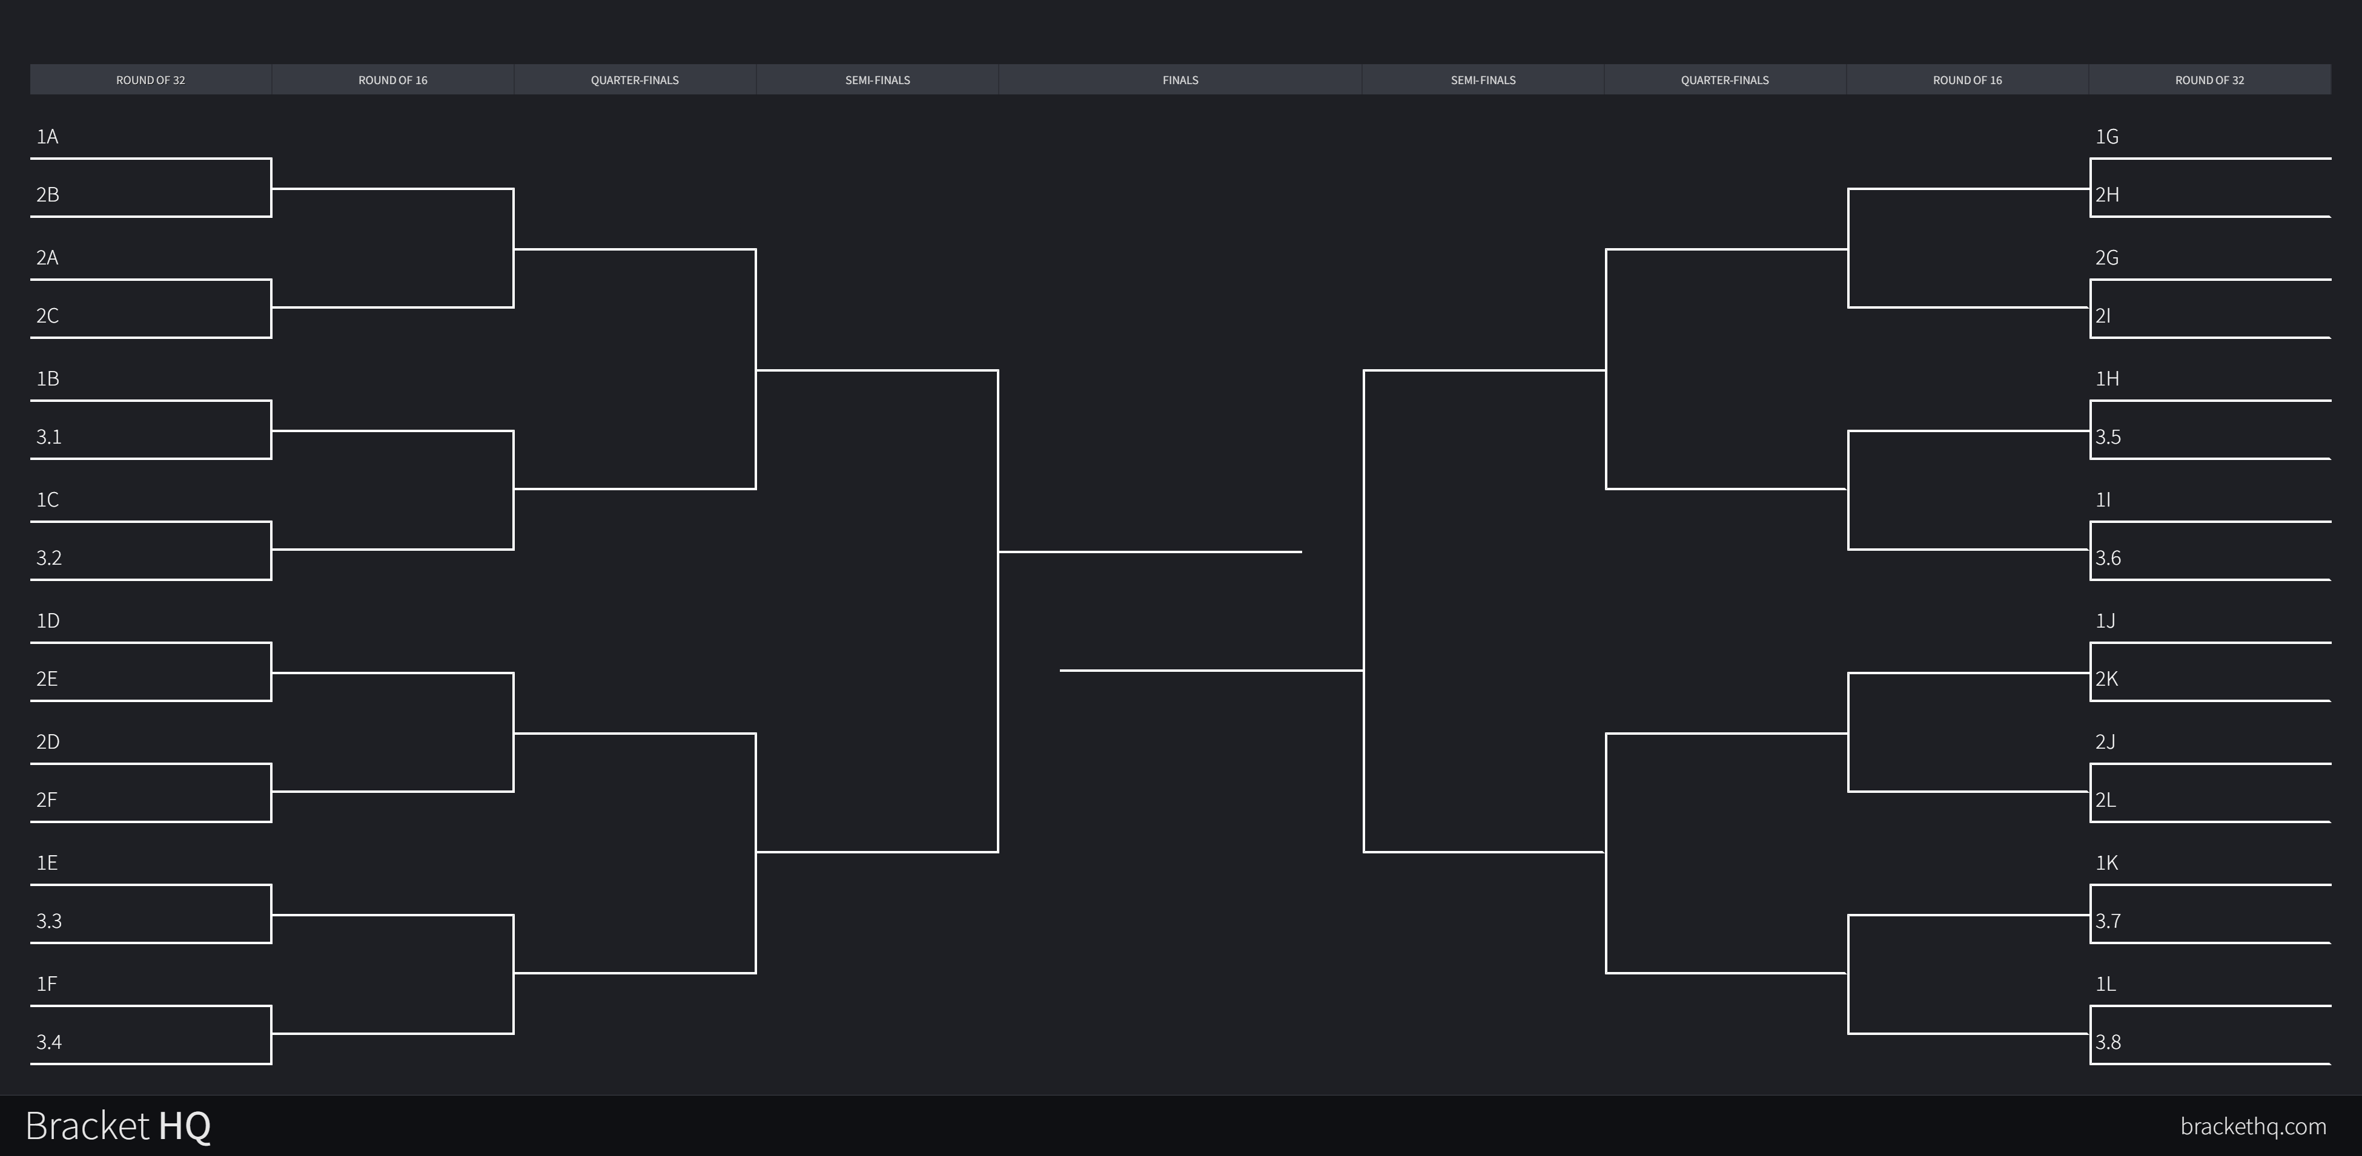
Projected 2026 Knockout Stage Format

Slide 10
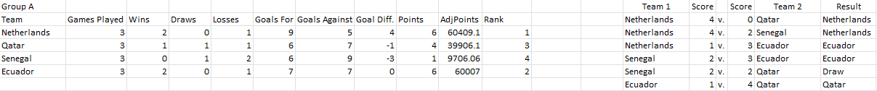
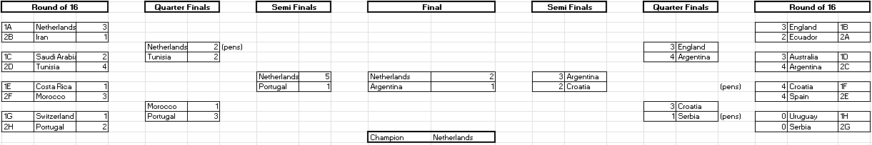
2022 World Cup Simulation
Group Stage
Knockout Stage

Slide 11
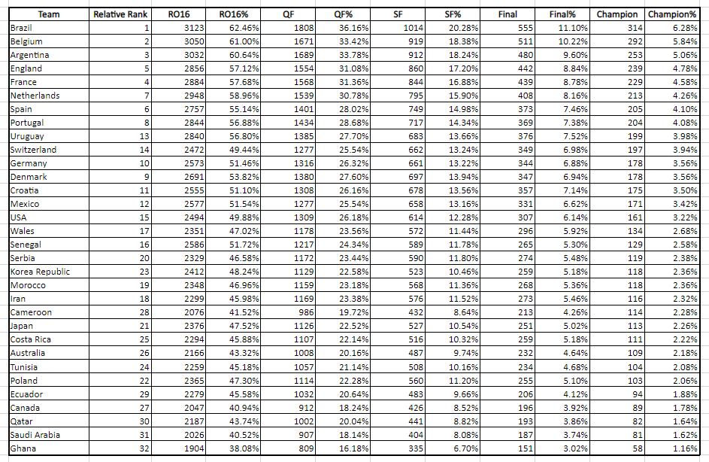
2022 World Cup Simulation Results (5000 Runs)
Not much variation in teams with high win percentage
Bottom ranked teams have the lowest win percentage, as expected
Teams like Uruguay and Switzerland overperformed, while Denmark and Poland underperformed.

Slide 12
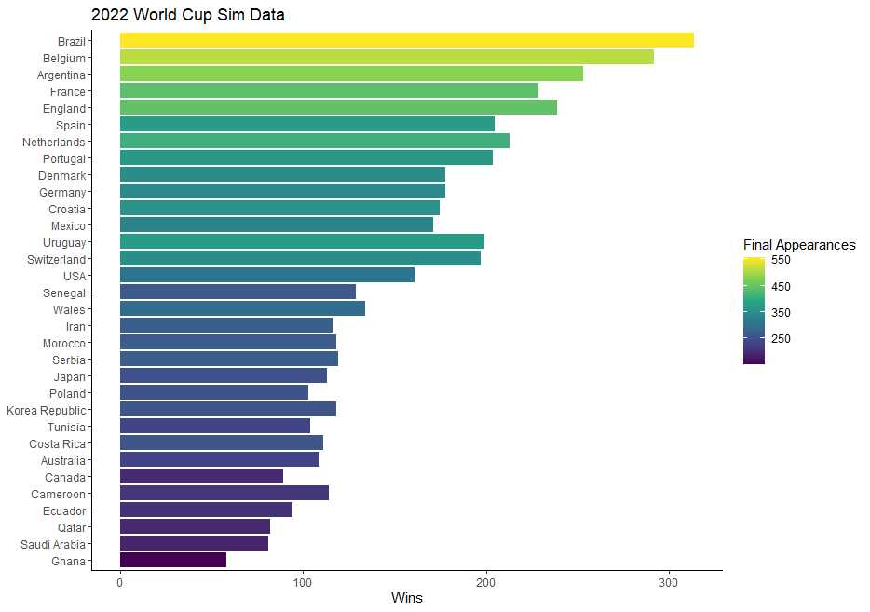
Our Findings
Again, we see little variation in teams with high win percentage
Lower ranked teams have the lowest win percentage and final appearances, as expected
Overperformance and underperformance are easier to see with this visual

Slide 13
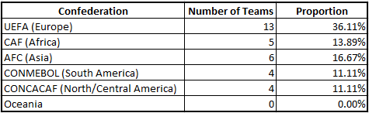
Our Findings (cont.)
Europe has the most teams by a large margin in the 2022 World Cup
Oceania had no teams in the 2022 World Cup
Asia and Africa had more teams than South America

Slide 14
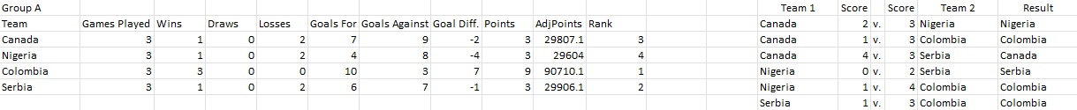
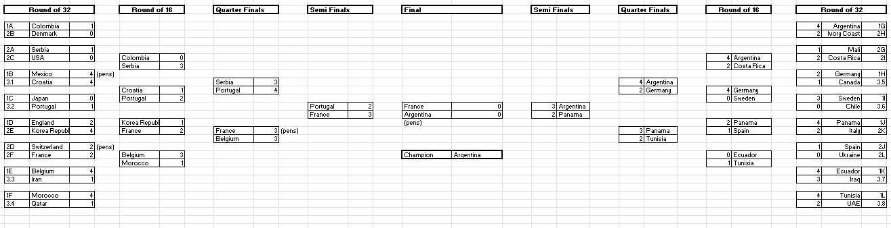
2026 World Cup Simulation
Group Stage
Knockout Stage

Slide 15
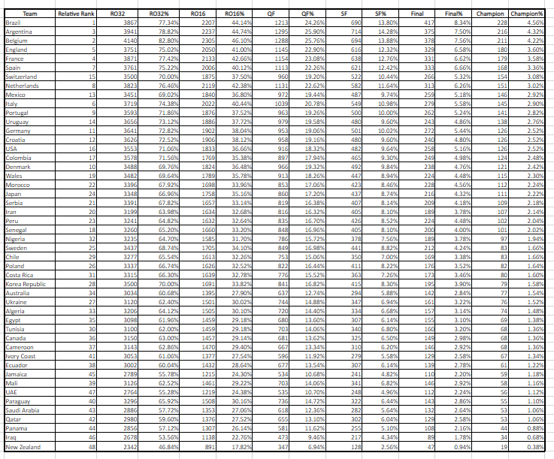
2026 World Cup Simulation Results (5000 Runs)
More variation in teams with high win percentage
Bottom ranked teams have the lowest win percentage, as expected
Teams like Mexico and Switzerland overperformed, while Denmark and Senegal underperformed.

Slide 16
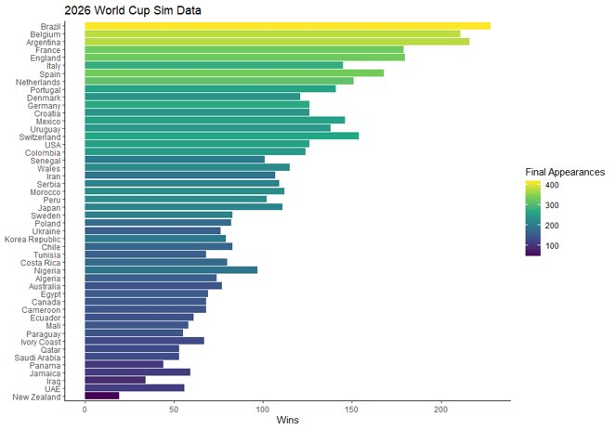
Our Findings
Again, we see more variation in teams with high win percentage
Lower ranked teams have the lowest win percentage and final appearances, as expected
Overperformance and underperformance are easier to see with this visual

Slide 17
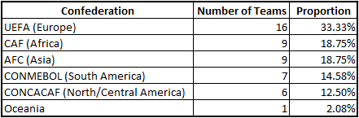
Our Findings (cont.)
Europe still has the most teams (by a smaller margin)
Oceania has a team representing them in 2026
South America has a bigger proportion of total teams than in 2022

Slide 18
Conclusions
Note that only 8 teams of the 80 that have competed in the World Cup have won, and no team outside of UEFA (Europe) and CONMEBOL (South America) has ever won.⁵
We saw that the expanded World Cup format led to more variation among the top teams, meaning that it is likely to see more teams winning the competition in the future. We will also get more competitors in the future that have never played in the cup.
The format changes will make the World Cup more accessible to teams across the world, making the competition true to its name.

Slide 19
Conclusions (cont.)
The teams that will benefit most from these changes are likely to be teams that are in the mid to upper tier of teams across the world. These changes make it more likely for them to win the World Cup.
The teams that will suffer most from these changes are likely to be the top tier teams. This is because winning the competition will be slightly more difficult for them, as they will have to win an extra game to be crowned champions.
Because the format changes will make the World Cup more accessible to teams across the world, as well as open the door to new winners, the changes will likely be looked at positively among fans across the world.

Slide 20
Sources
¹https://www.fifa.com/fifa-world-ranking/men?dateId=id13792
²https://digitalhub.fifa.com/m/f99da4f73212220/original/edbm045h0udbwkqew35a-pdf.pdf
³https://www.fifa.com/fifaplus/en/tournaments/mens/worldcup/qatar2022
⁴https://www.fifa.com/fifaplus/en/articles/fifa-world-cup-2026-hosts-cities-dates-usa-mexico-canada
⁵https://en.wikipedia.org/wiki/FIFA_World_Cup

